Slide 1
Jakub Michalek
g00316039

Slide 2

The Premise :

Slide 3
The Purpose:
Create a basic fitness application that can be further developed by a company.
No Hardwiring
Applicable Within Ionic Framework Machines
Same Quality Across All Systems

Slide 4
The Challenge :
Build a basic Ionic Framework application
Set it up in a way that is clear to use and read
Allow for easy changes by third party
Create an initial design following one scheme

Slide 5
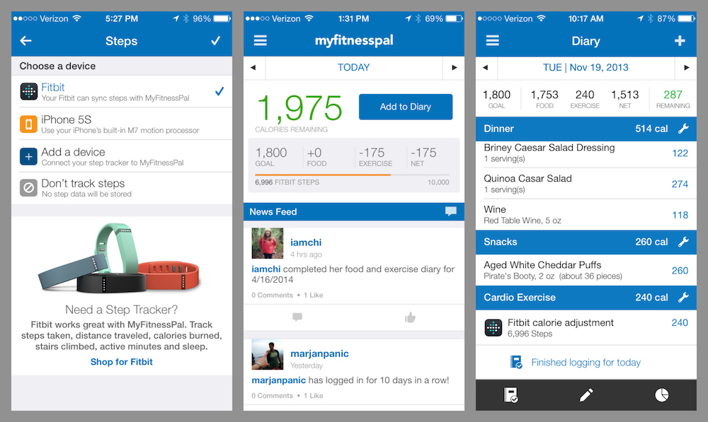
The Struggle:

Slide 6
The Clarity of Mind:
Points taken :
Clear Design
Few Tabs
Sporadic use of Color
Color coding the important stuff
Social Interaction
Monetization
Monetization 2 – The User good will

Slide 7
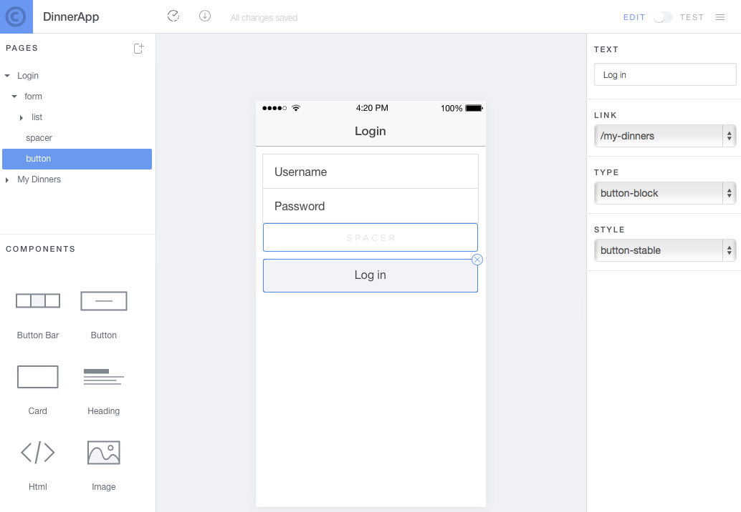
The Forge:

Slide 8
The Identity:
Basic Design
Clarity
Space for Ads
Ability to rewire
Stock Photos
Proof of Concept

Slide 9
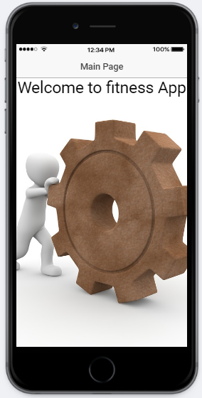
The Deed:
https://creator.ionic.io

Slide 10
The Conclusion:
What Did I learn?
What abilities came in handy?
Do I have plans to continue development in the future?
Is there place for application skeletons on the market?
Am I happy with the application.

Slide 11
References:
http://blog.myfitnesspal.com/wp-content/uploads/2014/05/MyFitnessPal-Steps.jpg
http://gonehybrid.com/content/images/2015/02/login-view-1.png
http://translate.google.ie

